Slide 1
Mapping ER diagrams to tables
The ER model is convenient for representing an initial, high-level database design. Now we will see how we can translate an ER diagram into a collection of tables, that is, a relational database schema.
Entities to tables:
An entity is a real-world object with some attributes. We can map entities to tables by,
Create table for each entity.
Each attribute of the entity set becomes an attribute of the table, with their respective data types.
Declare primary key.

Slide 2
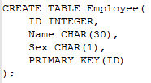
For example, consider the “Employee” entity as shown below –
The following SQL statement captures the above information,
Name
ID
Sex
Employee

Slide 3
Relationships to tables:
Create table for a relationship.
Add the primary keys of all participating entities as fields of table with their respective data types.
If relationship has any attribute, add each attribute as field of table.
Declare a primary key composing all the primary keys of participating entities.
Declare as foreign key fields the primary key attributes of each participating entity.
For example, consider the “Works_In” relationship as shown below -

Slide 4
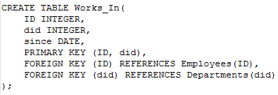
The following SQL statement captures the above information,
since
Name
did
dname
ID
Sex
Works_In
budget
Employee
Department

Slide 5
Consider the relationship “Manages” as shown below –
The table corresponding to Manages has the attributes ID, did, since. However, because each department has at most one manager, no two records can have the same did value but differ on the ID value.
Hence did is itself a key for Manages and not the set ID, did.
Name
since
ID
Sex
dname
did
Manages
budget
Employee
Department

Slide 6
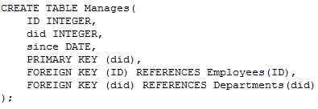
The Manages relation can be defined using the following SQL statement,
Example:
Consider the university ER model discussed in slide 13 of Day 2. Let us translate this ER diagram into a relational model by writing the SQL statements.
Let us import the ER diagram for convenience.

Slide 7
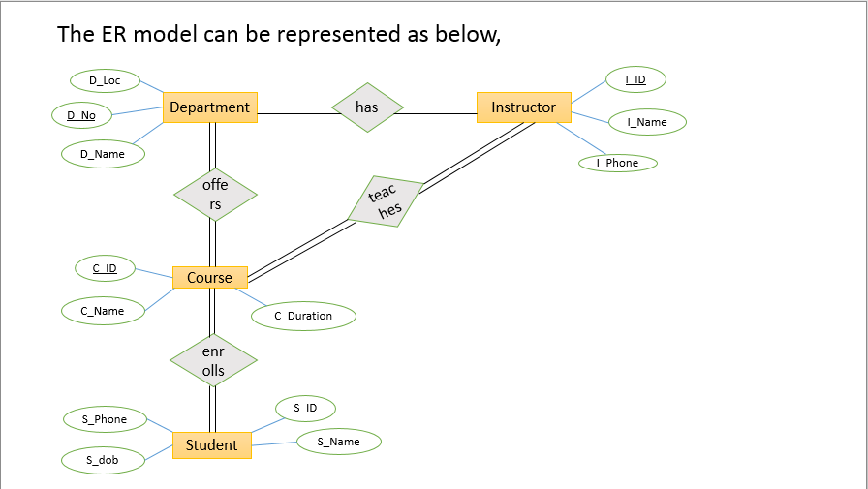

Slide 8
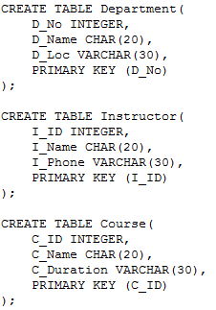
The following SQL statements captures the required information,

Slide 9
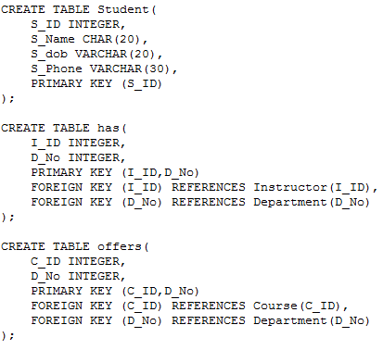

Slide 10
